Slide 1
High needs funding

Slide 2
High needs funding – Stage 2 consultation
The context – how material the reform is and where it fits in
Why – is reform needed?
What – is the objective of the reform?
How – does it work? And what are the detailed proposals?
Impact – how will it affect different Las and different settings?

Slide 3
High needs funding – current context
High needs block accounts for over £5bn out of total schools expenditure of £40bn+
In parallel with Schools Block this is Stage 2 of consultation
Clear that reform of Schools Block could not be undertaken without reform of high needs
History – Isos study in 2015 followed by Stage 1 consultation in March 2016; Stage 2 in December 2017
Lead on high needs remains with local authorities
69% of 1075 responses to Stage 1 supported funding principles and 79% supported most high needs funding going to LAs

Slide 4
High needs funding – initial consultation outcomes
“Current distribution largely based on LAs’ spend in 2012-13 which in turn strongly related to spending patterns from 2005-06”
“significantly different levels of funding for high needs across the country, which .. cannot be justified by reference to any measure of need.”
Current funding is not targeting need and Government sees need for fairer distribution and better use of funding committed to high needs
“Areas ..that have been underfunded will begin to see increases that will help them to achieve more for their children and young people”

Slide 5
High needs funding – principles for reform
Move to fairer distribution based on need
Maintaining stability at same time as change
Funding principles
Better use of limited funding

Slide 6
High needs funding – overarching proposals
No local authority will face a reduction in high needs funding compared with their current spend
Gains of up to 3% over 2 years for authorities currently underfunded
£200m of capital funding for places for pupils with SEND

Slide 7
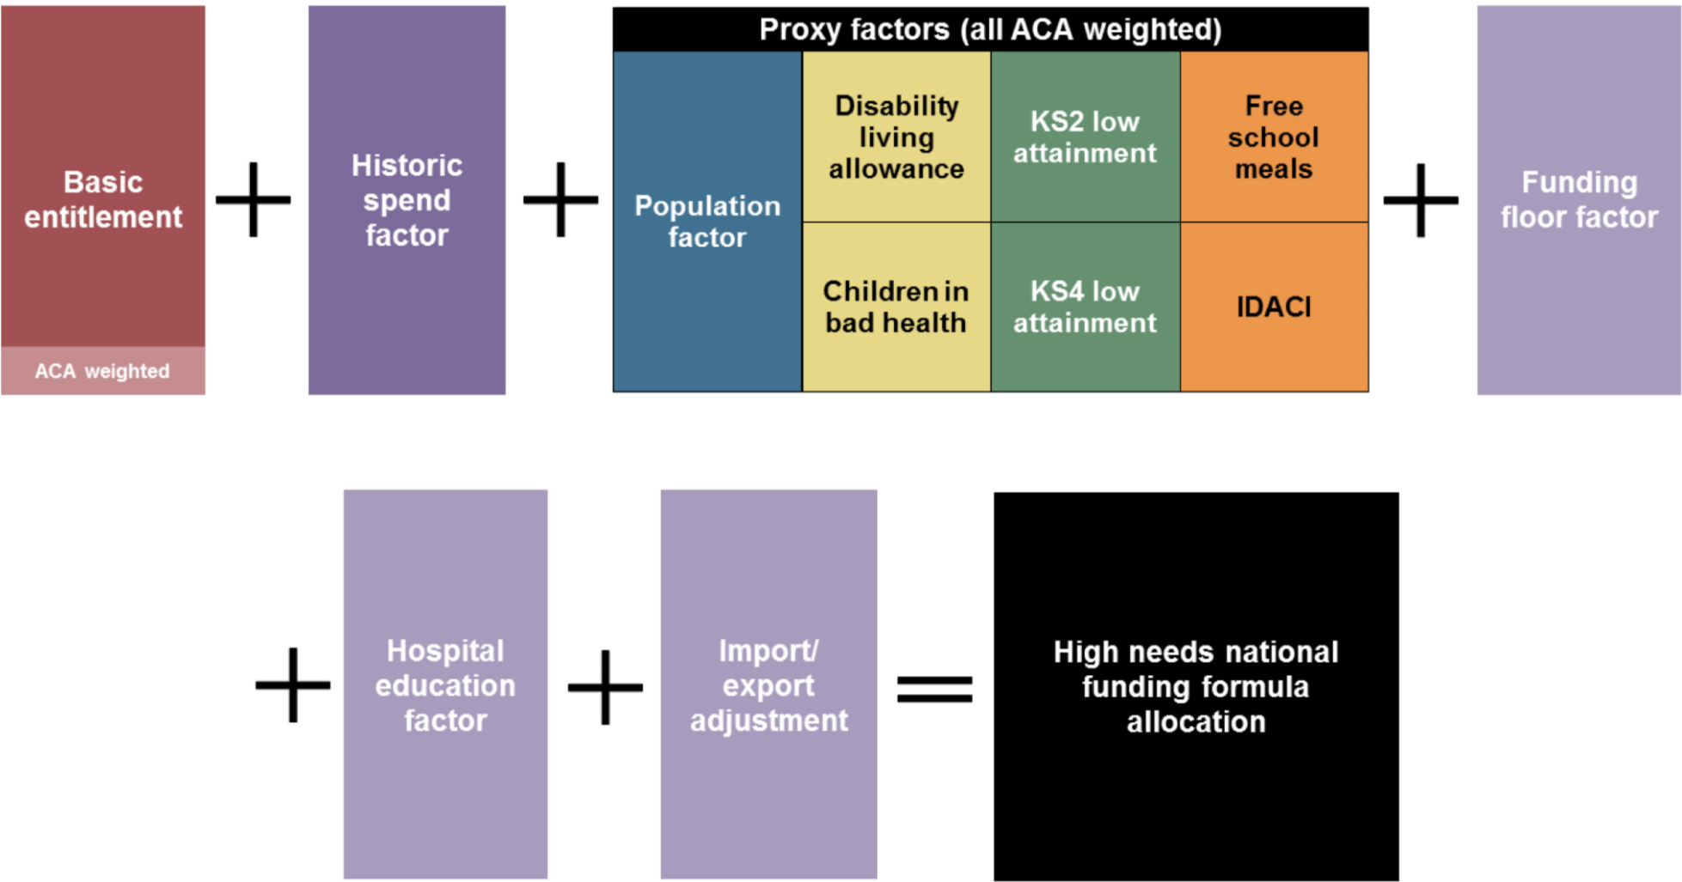
High needs funding – formula model
Proposed formula will use 8 formula factors and two adjustments – one for area costs, the other for imports and exports.

Slide 8
High needs funding – local impacts
Local authority impact
Wide range of impact – highlights are
Yorkshire and Humberside + £49 million; 13 out of 15 LAs gain; largest gain 20%
Inner London + £3 million; 5 out of 13 LAs gain; largest gain 4.7%
In the short term no losses and gains restricted to 3% in each of first two years
Longer term not clear, but first two years will have levelled the distribution significantly – so completion of the formula easier

Slide 9
High needs funding – the cash floor
Losers are protected by cash floor
But even if the floor continues beyond 2019-20, some LAs will be marking time for many years
Can be identified by the level of the floor factor. Examples:
    Merton – floor factor is 16.9% of original baseline
    Bracknell Forest – floor factor is 15.7% of original baseline
    Buckinghamshire – floor factor is 19.5% of original baseline
LAs in this position face a static high needs allocation for some time

Slide 10
High needs funding – two key NASUWT principles
The setting in which a pupil is educated should be determined by an objective assessment of his or her needs, not by ideology or funding considerations.
  Historical funding element critical in this respect – funding solely on a per pupil basis would create financial incentives to move pupils to special provision– each local authority is very different.
Schools and other agencies for children should collaborate in meeting the needs of pupils with SEND
  Flexibilities to share funding and to move funding between blocks is critical to this – ring fencing of the schools block could be a problem from 2019/20 – serious potential implications for inclusive schools.

